Slide 1
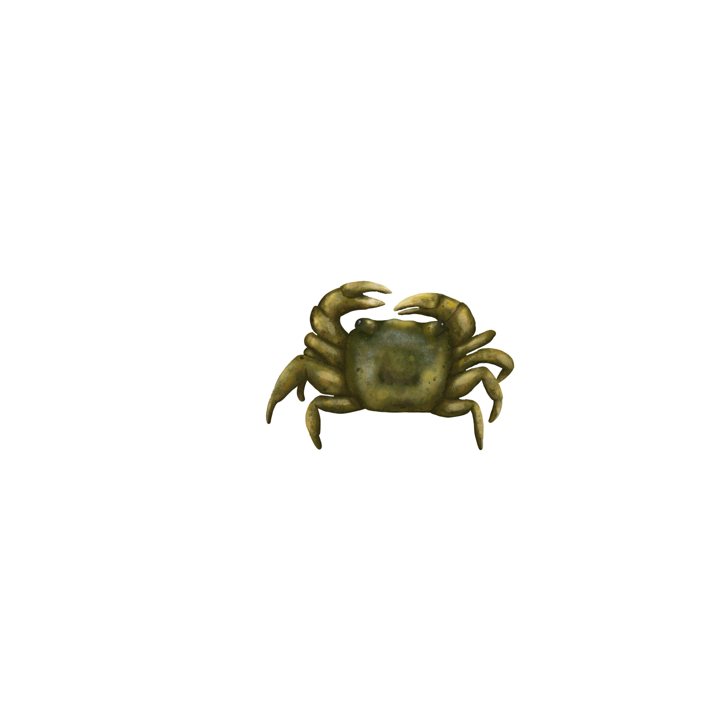
Final Presentation:
Impacts of temperature on immune response in Hemigrapsus oregonensis
Emily Charles, Isaac Gonzalez, Kea McKay, Luke Shively

Slide 2
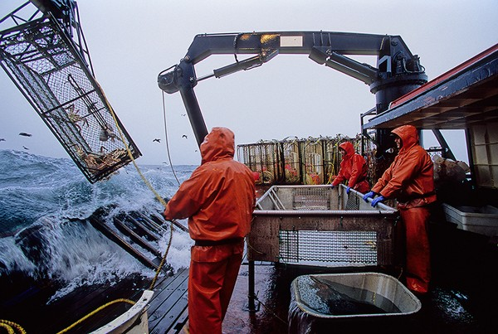
Introduction
Crabs are important!
Snow crab (~US$200 million ex-vessel industry in East Bering Sea prior to collapse) and Dungeness crab fisheries (Close to US$70 million ex-vessel industry in Washington state) are important to the economies of the northeast Pacific
Studying hairy shore crabs (Hemigrapsus Oregonensis) in lab might allow us to better understand how crabs interact with pathogens amidst temperature rise

Slide 3
Background
Warming Oceans: Anthropogenic driving is causing atmospheric warming, and oceans absorb this heat. The way this heat dissipates through marine systems may affect the physiology of many key species
2024 warmest sea surface temperatures on record (EPA)
Impacts to species distribution, reproductive success, and metabolic rates (Shields 2019; Dehnel 1960)
Thermal stress can reduce thresholds to infection (Dehnel 1960)
Pathogen Exposure: Within a changing climate, pathogen prevalence is shifted.
Bitter crab disease correlated with temperature increases and population density (Balstad et al. 2024)
Host-pathogen interactions are expected to change in several ways (Cohen et al. 2018)
Host stress levels
Pathogen transmission
Pathogen habitat and range
Host habitat and range

Slide 4
Research Question
What are the impacts of temperature on the immune response of H. oregonensis?
H0: There is no resulting difference in immune response between crabs treated with and without heat treatments
Haemocyte count
Glucose
Respiration
Righting Time
Ha: Immune response is displayed in crabs treated with heat by decreases in haemocyte count and increases in the stress response

Slide 5
Control
Group 1: Heat, Mud
Group 2: No Heat, Mud
Group 3: Control, No Mud
13˚C
This control will help determine the impact the pathogens have so we can hopefully pinpoint the heat impact .
Control Tank
This treatment will help determine how heat and exposure to pathogens affects crab immune systems.
This treatment will help determine the impact heat have on the crabs, so we can hopefully separate the heat impact from the mud impact.
27˚C
13˚C
27˚C
* 6
* 6
* 6

Slide 6
Temperature
Mud
Covers
A temperature increase to 27 C was chosen to simulate possible temperature changes due to climate change. Temperature was lowered to 27 C, as suggested post proposal.
A 1 ½ inch layer of mud was chosen to simulate bacteria and infectants crabs may be exposed to in their natural habitat. Depth was chosen to provide significant hiding space, while allowing the same volume of water in all 3 tanks.
Two oyster shells were placed on opposing sides of the tank to simulate rocks and other natural habitat structures to help prevent additional stress due to being exposed.

Slide 7
Haemocyte Concentration
Immune Response:
Haemolymph was collected using a needle from the coxa joints of the crabs. Haemocytes were then counted using a hemocytometer.
Physiological assays
Stress:
Righting time was measured by gently placing the crabs on their back and timing how long it took them to right themselves.
Haemolymph was used to measure Glucose.
Respirometry
Stress:
Measured resazurin levels at 30, 60, and 90 minutes using a Resazurin assay.

Slide 8
Replication:
Sample Size:
Six crabs allowed for three replicated tests for each treatment, three designated for resazurin and three for haemolymph extraction.
Six crabs/treatment and using lab control crabs for no heat and no mud control treatment allowed for the highest replication options given the small sample size.
6 crabs allowed for three replicated tests for each treatment.
6 crabs allowed for three replicated tests for each treatment.

Slide 9
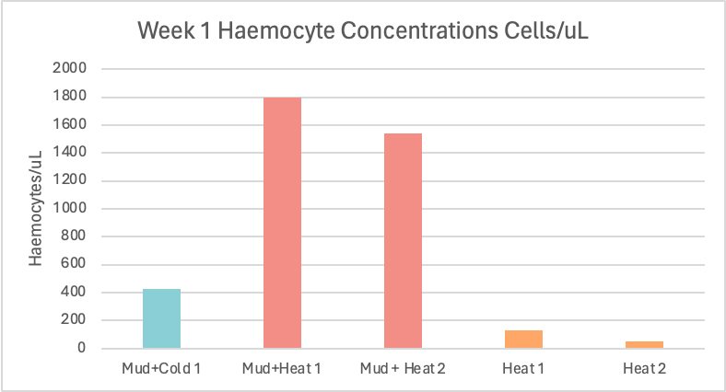
Results-Haemocyte Concentrations Week 1
Week 1, haemocyte concentrations were highest in the mud+heat treatment groups, ranging from ~1800/uL to ~1500/uL .
Second highest Haemocyte count was seen in the mud+cold group, ~400/uL.
This suggests the mud was successful at simulating pathogens.
The 27C group without mud had counts below 200.
Suggests immune response in mud tanks, with a higher response under elevated temperatures

Slide 10
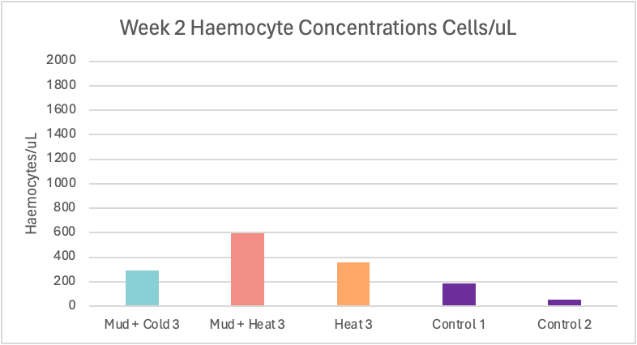
Results-Haemocyte Concentrations Week 2
Week 2 saw a decrease in haemocyte concentrations in both mud treatment groups.
Mud+heat dropped to ~600/uL and mud+cold to ~300/uL.
The 27C treatment saw an increase to ~400
Control haemocyte concentrations were 200/uL and <100/uL, suggesting an elevated hemocyte concentration in mud groups.

Slide 11
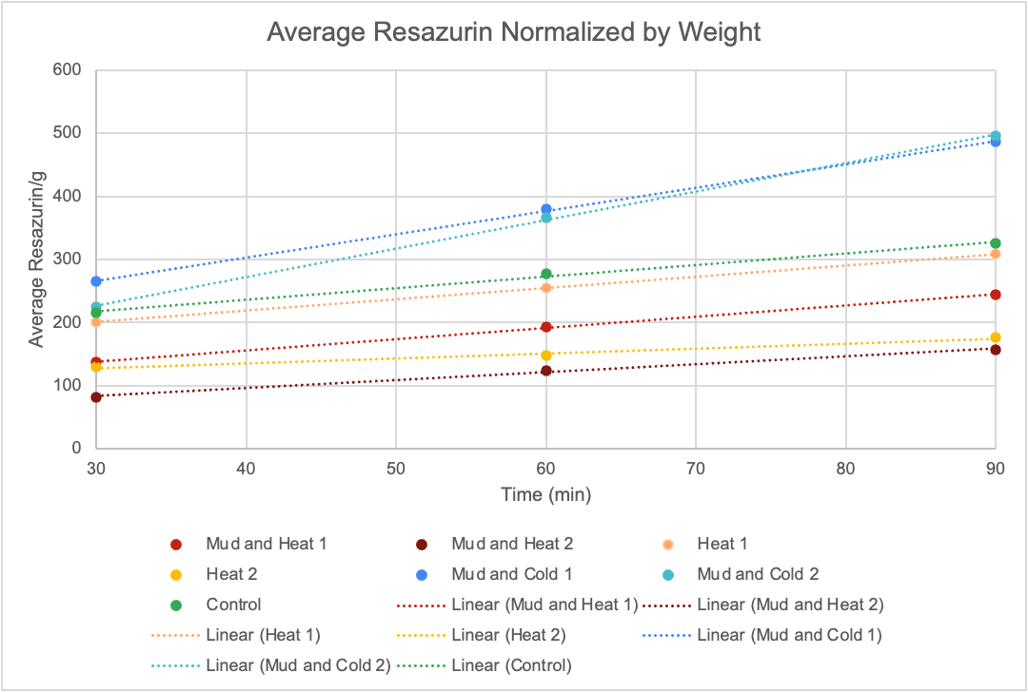
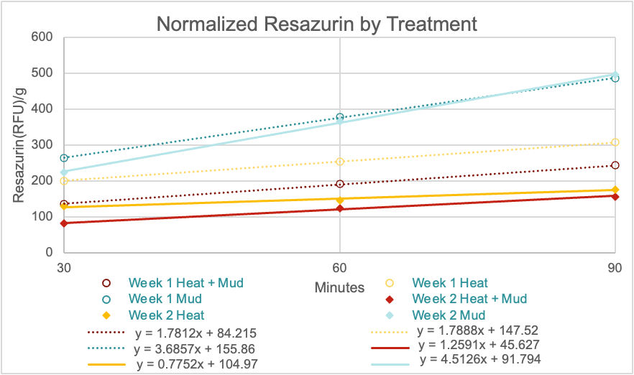
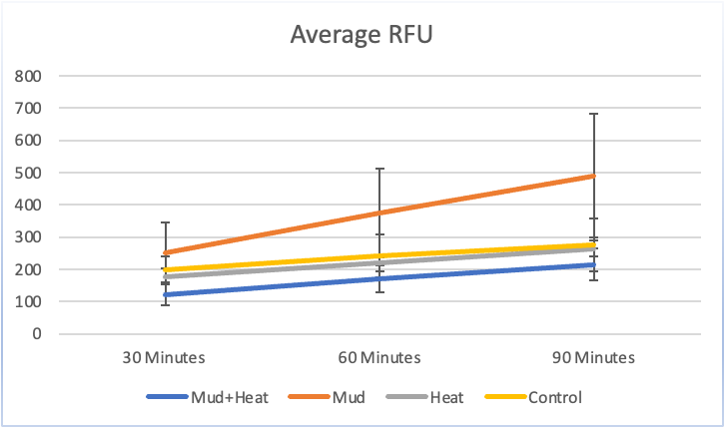
Results- Resazurin
RFU was the highest in the mud treatment group at 13C.
The mud+heat and heat groups has little statistical difference
Mud+heat group had the lowest RFU
Control had second highest RFU

Slide 12
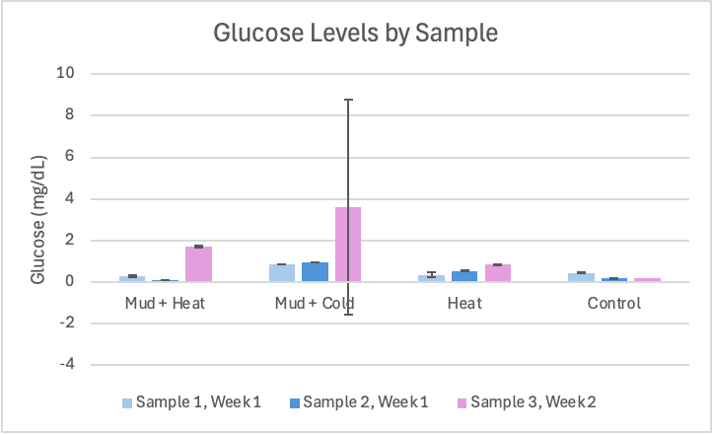
Results-Glucose levels
Mud+heat had low levels of glucose in week 1 with an increase in week 2
Similar pattern in mud+cold but with higher glucose levels, large standard deviation in week 2
Glucose levels increase slightly in week 2 of heat treatment but less so than mud treatments
Control glucose levels decreased over time

Slide 13
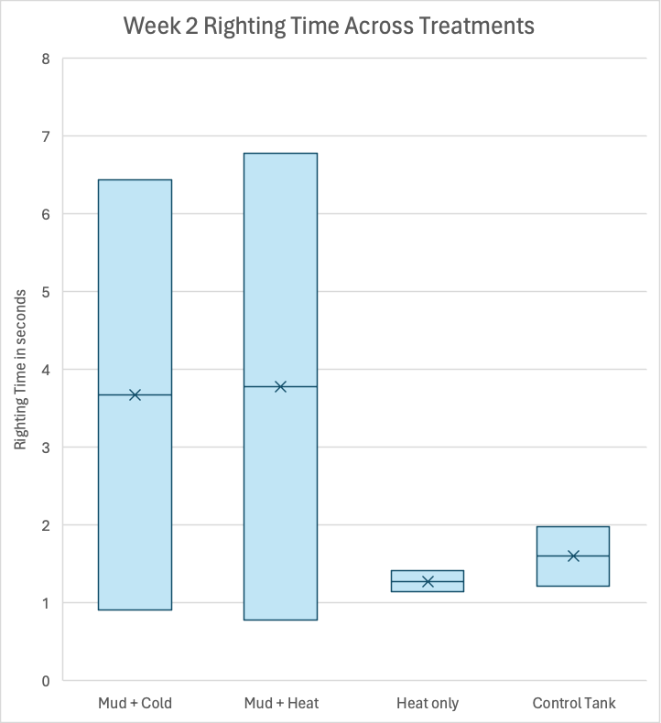
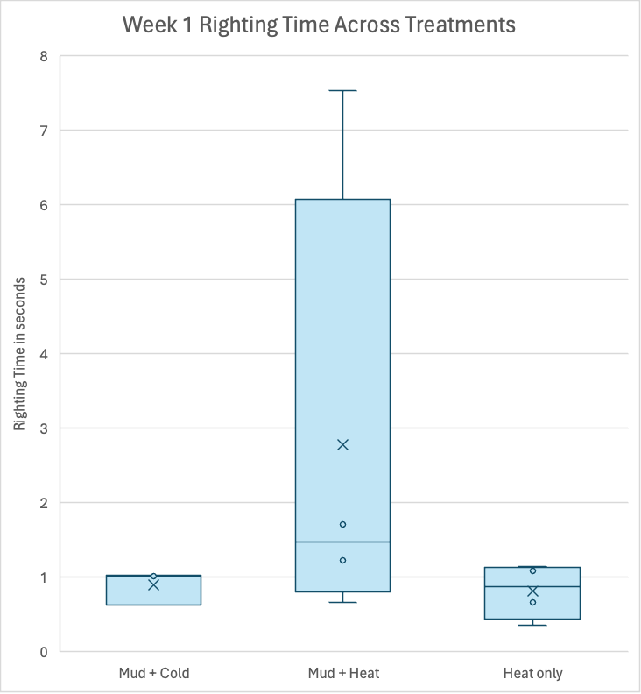
Results-Righting Time
Righting time was the highest in mud+heat group
Control righting time average ~1.5 seconds
Mud+cold had very much different righting time in week 2

Slide 14
Conclusion - Righting time and Resazurin
In mud + 27˚C treatment we hypothesized…
Righting time Respiration Rate (RFU/min)
Result: fail to reject the null hypothesis, lots of variability
!
Small sample size
Handling stress

Slide 15
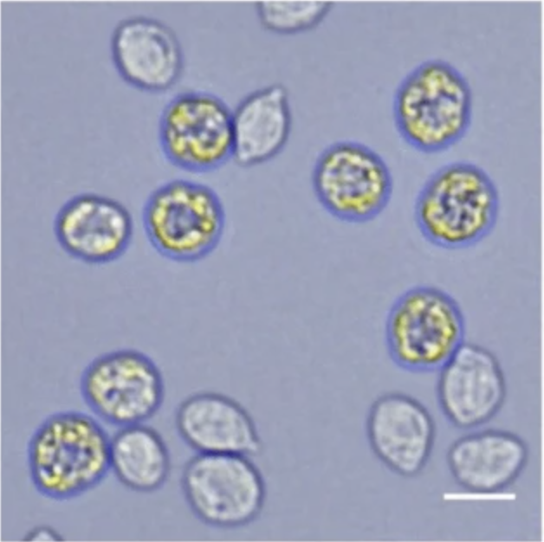

Conclusion - Haemocyte and Glucose Concentrations
In mud + 27˚C treatment we hypothesized…
Haemocyte concentration Glucose Concentration
Haemocyte concentration Glucose Concentration
Conspecific consumption in
mud + 27˚C
Feeding in mud treatments
Koiwai et al. 2019
Notes:
Haemocyte concentrations in the mud+heat group were much higher than other treatments in week 1, indicating a stronger immune response. This is possibly due to a larger pathogen load, since many microbes experience higher growth rates under higher temperatures. We saw a decrease in hemocyte concentration for the mud+heat group in week 2, and this may be an indicator of immune suppression, although with small sample sizes, it is difficult to justify this, as we have only one sample in week 2, and the hemocyte concentration is still higher than control values.
Glucose concentrations in the mud and heat treatment group were not statistically different from the control value except for in our sample from week 2, and we know there was a crab that was eaten by the other crabs between weeks, so that explains the higher glucose level. In both mud treatments, there is potential for the crabs to consume organisms living in the mud, which may be why the variation is so high in the mud and 13˚C treatment.

Slide 16
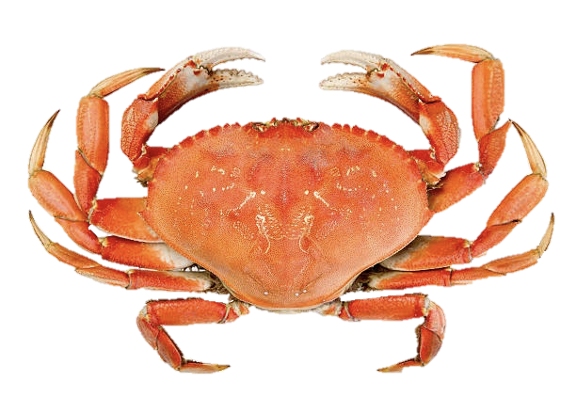
Conclusion - Implications and Context
Increased immune response is energetically taxing
Risk of coupled impacts of heat stress and increased immune stress
Risk of pathogen range expansion
Threat for Dungeness crab fisheries
Decreased growth and reproduction
NOAA Fisheries
Notes:
While we did not have significant evidence of immune suppression with increasing temperature as we predicted, we do have evidence of an elevated immune response.

Slide 17
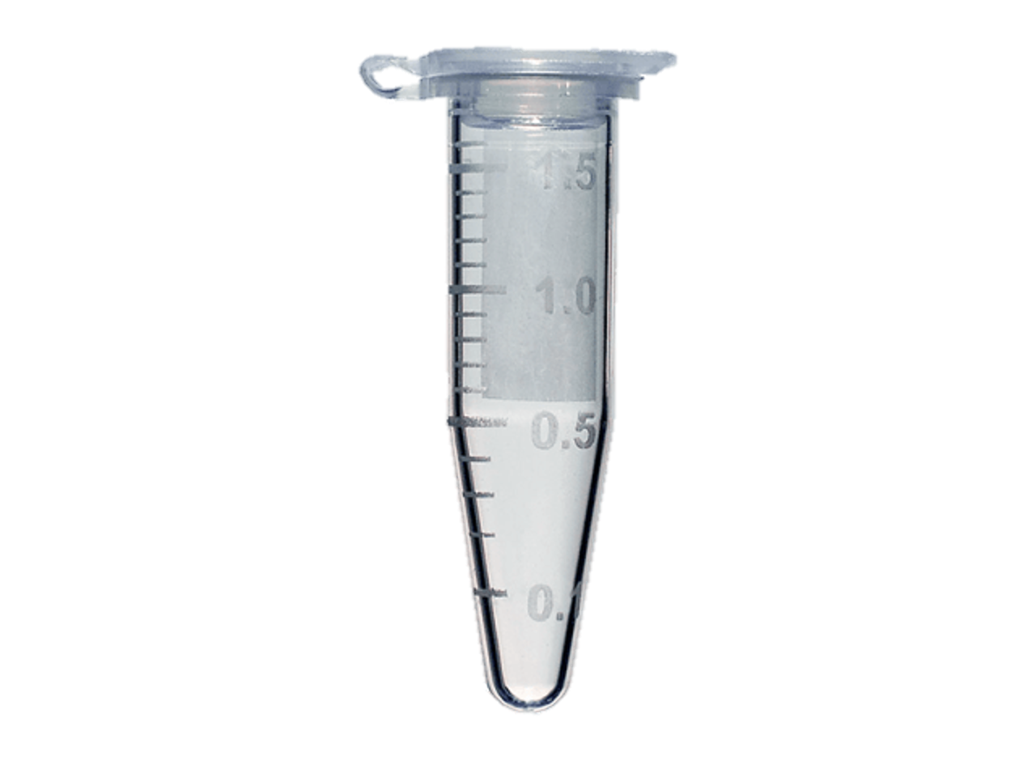

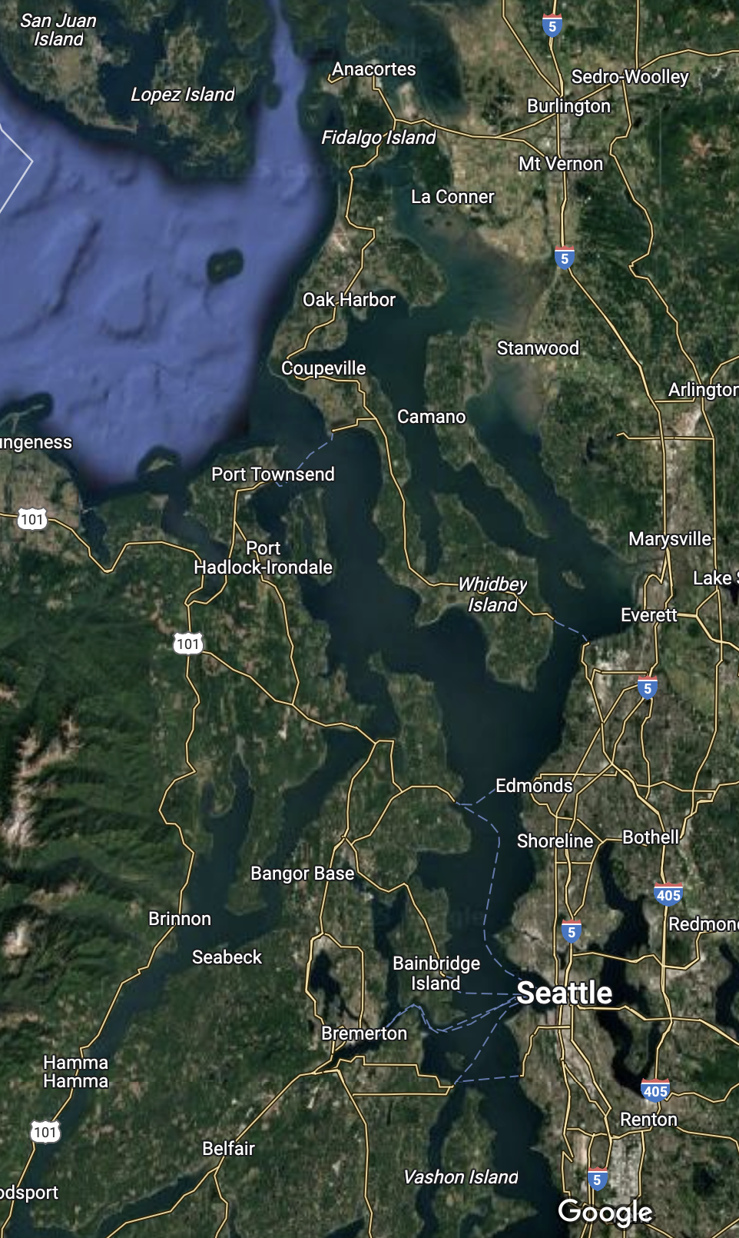
Future Directions
Further hemolymph assays and stress assessment
Replication
Does immune suppression occur?
Longer treatment exposure
Do different mud treatments have different pathogen impacts?
Known pathogen load
and
Different mud collection locations
Sterile Substrate

Slide 18
References
Adamo, S. A. (2012). The effects of the stress response on immune function in invertebrates: An evolutionary perspective on an ancient connection. Hormones and Behavior, 62(3), 324–330. https://doi.org/10.1016/j.yhbeh.2012.02.012
Alaska Fisheries Science Center. (2025, March 3). Snow crab collapse due to ecological shift in the Bering Sea. NOAA Fisheries. https://www.fisheries.noaa.gov/feature-story/snow-crab-collapse-due-ecological-shift-bering-sea
Balstad, L. J., Fedewa, E. J. & Szuwalski, C. S. Drivers of bitter crab disease occurrence in eastern Bering Sea snow crab (Chionoecetes opilio). ICES Journal of Marine Science 81, 1073–1083 (2024).
Climate change indicators: Sea surface temperature. (2023, July 21). US EPA. https://www.epa.gov/climate-indicators/climate-change-indicators-sea-surface-temperature
Cohen, R.E., C.C. James, A. Lee, M.M. Martinelli, W.T. Muraoka, M. Ortega, R. Sadowski, L. Starkey, A.R. Szesciorka, S.E. Timko, E.L. Weiss, and P.J.S. Franks. 2018. Marine host-pathogen dynamics: Influences of global climate change. Oceanography 31(2):182–193, https://doi.org/10.5670/oceanog.2018.201.
Dehnel L, P. A. (1960). Effect of temperature and salinity on the oxygen consumption of two intertidal crabs. The Biological Bulletin, 118(2), 215–249. https://doi.org/10.2307/1538998
Dittmer, J., Koehler, A. V., Richard, F.-J., Poulin, R., & Sicard, M. (2011). Variation of parasite load and immune parameters in two species of New Zealand shore crabs. Parasitology Research, 109(3), 759–767. https://doi.org/10.1007/s00436-011-2319-2
Shields, Jeffery, Climate change enhances disease processes in crustaceans: case studies in lobsters, crabs, and shrimps, Journal of Crustacean Biology, Volume 39, Issue 6, November 2019, Pages 673–683, https://doi.org/10.1093/jcbiol/ruz072
Snow crab collapse due to ecological shift in the Bering Sea. (2024, August, 21). NOAA. https://www.fisheries.noaa.gov/feature-story/snow-crab-collapse-due-ecological-shift-bering-sea
Truscott, R., & White, K. N. (1990). The Influence of Metal and Temperature Stress on the Immune System of Crabs. Functional Ecology, 4(3), 455–461. https://doi.org/10.2307/2389609
Washington Coastal Dungeness Crab Fishery Newsletter. (2024). Washington Department of Fish & Wildlife. https://wdfw.wa.gov/sites/default/files/2025-01/newsletter-dungeness-crab-fishery-2024-5.pdf

Slide 19
Thank you!
Any questions?

Slide 20
Criteria | Ratings | Pts
This criterion is linked to a Learning Outcome Introduction Clearly states the topic, its importance, and relevance to the broader field | 1 pts Full Marks 0 pts No Marks | 1 pts
This criterion is linked to a Learning Outcome Background Summarizes relevant literature or prior research and sets up the study's context | 3 pts Full Marks 0 pts No Marks | 3 pts
This criterion is linked to a Learning Outcome Research Questions Articulates focused, testable research questions or hypotheses | 2 pts Full Marks 0 pts No Marks | 2 pts
This criterion is linked to a Learning Outcome Experimental Design & Methods Describes procedures with clarity and justifies methods used; appropriate controls, replication, and sample sizes are addressed | 3 pts Full Marks 0 pts No Marks | 3 pts
This criterion is linked to a Learning Outcome Results Data are clearly presented (figures/tables); results are accurate and well organized | 4 pts Full Marks 0 pts No Marks | 4 pts
This criterion is linked to a Learning Outcome Interpretation/Conclusions Thoughtful interpretation of data; conclusions are supported and placed in context of the hypothesis | 4 pts Full Marks 0 pts No Marks | 4 pts
This criterion is linked to a Learning Outcome Future Work Proposes logical next steps, unanswered questions, and potential applications | 1 pts Full Marks 0 pts No Marks | 1 pts
This criterion is linked to a Learning Outcome Clarity, Deliver, and Style Speaks clearly, professionally; maintains audience engagement; time-managed. Slides are readable, well-designed, and free from distracting errors. | 2 pts Full Marks 0 pts No Marks | 2 pts
Final presentation
Total Points: 20

Slide 21
Future Directions
Longer treatment exposure
Replication
Immune suppression?
Different mud collection locations
Known pathogen load
Further hemolymph assays and stress assessment
Pathogen impacts?
Sterile Substrate

